Slide 1


Why Most Companies Fail
And How 9 AI Assistants Can Save Yours
Next

Slide 2
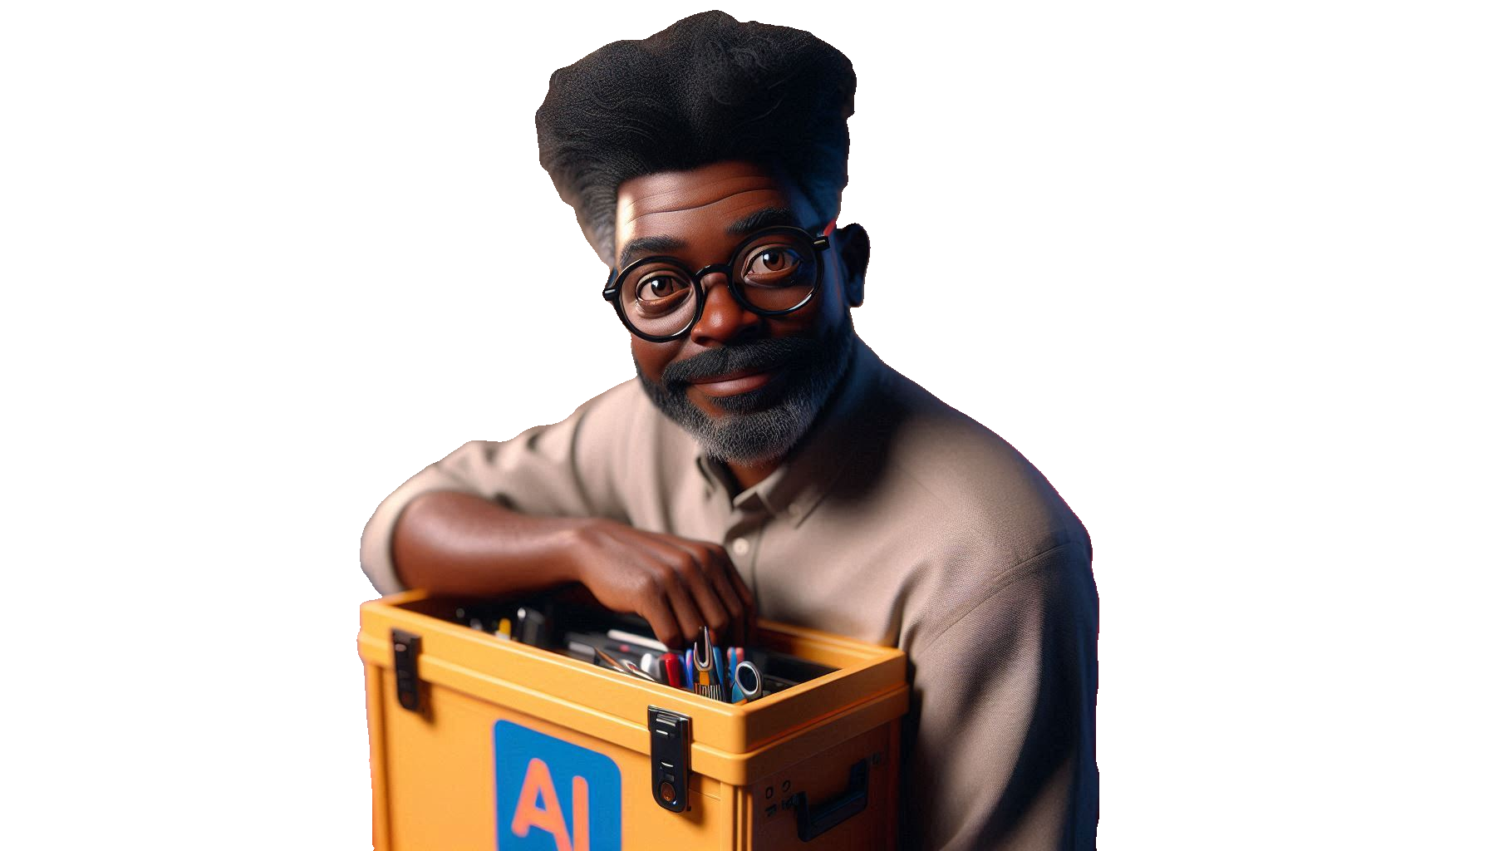
The #1 Startup Killer
90% of companies fail but because they can’t reach their market.
Next

Slide 3

Why Is Go-to-Market So Difficult?
Lack of expertise, scattered tools, and unclear strategy hold most founders back.
Next

Slide 4
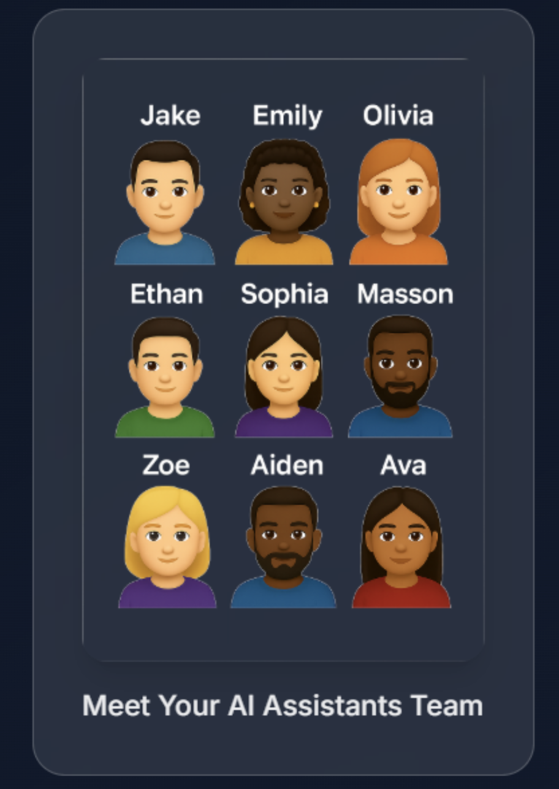
Meet 9 Assistants
80+ Experts
1 Platform
All your Sales, Marketing, and Market Research needs under one roof.
Next

Slide 5
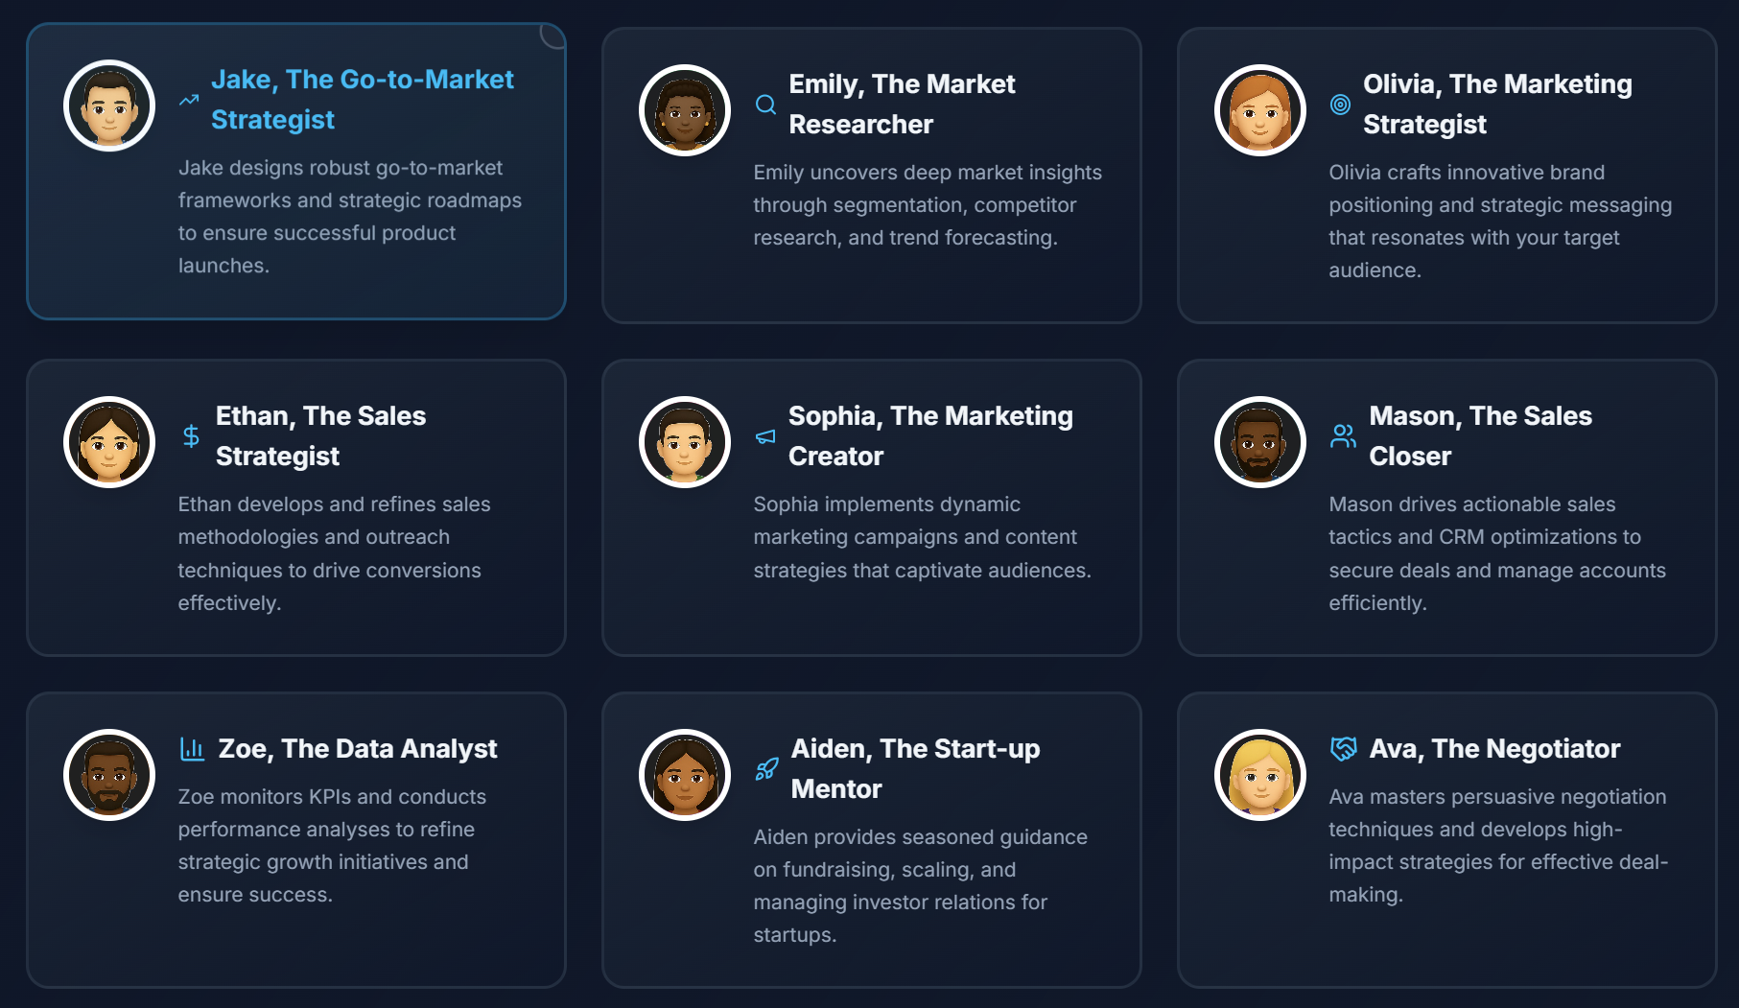
Meet your 9 AI Assistants Team
Jake, Emily, Olivia, Ethan, Sophia, Masson, Zoe, Aiden, Ava—each an expert in their field.
Next

Slide 6
What Can They Do For You?
From finding your ideal customer to crafting the perfect campaign—every GTM task, covered.
Next

Slide 7
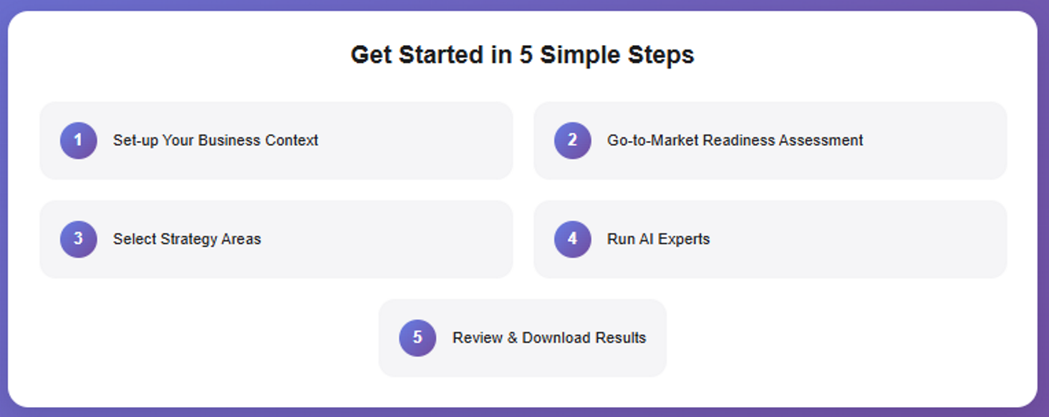
How It Works?
Next

Slide 8

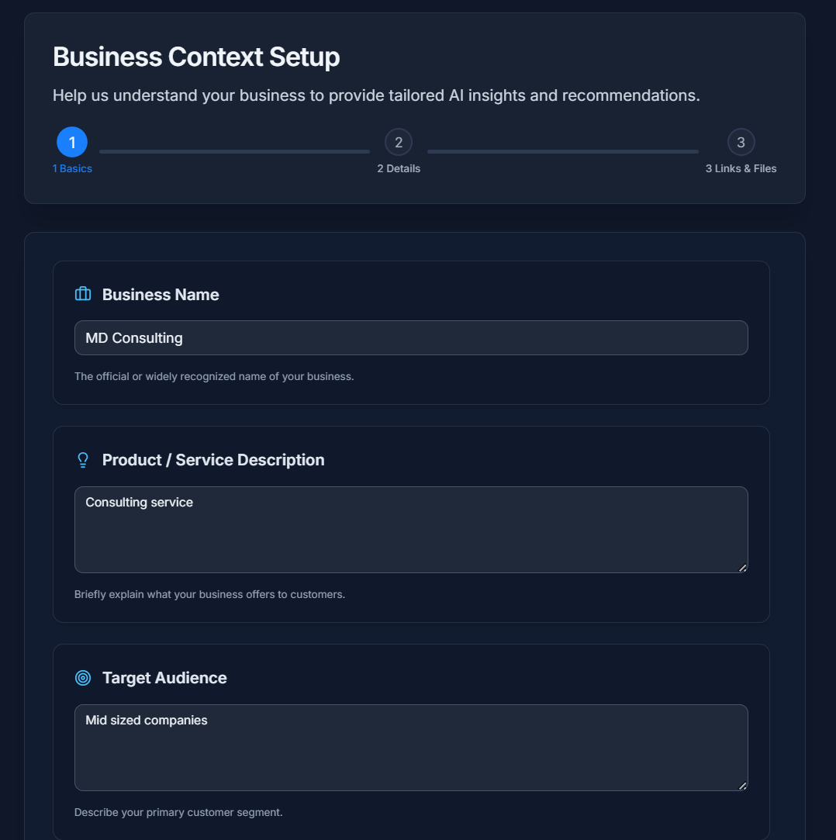

Personalized Customer Journeys
#2
Set-up Business Context
Next
                David Merzel
                www.davidmerzel.com

Slide 9

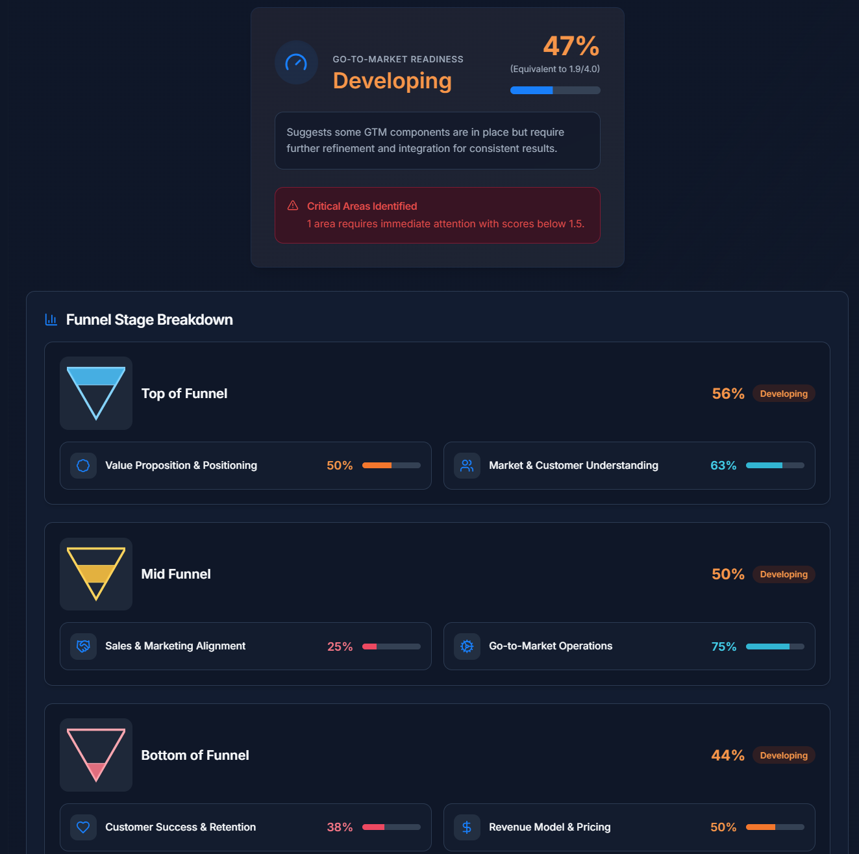
Predictive Sales Forecasting
#3
Your Go-to-Market
Readiness Assessment
Next
                David Merzel
                www.davidmerzel.com

Slide 10
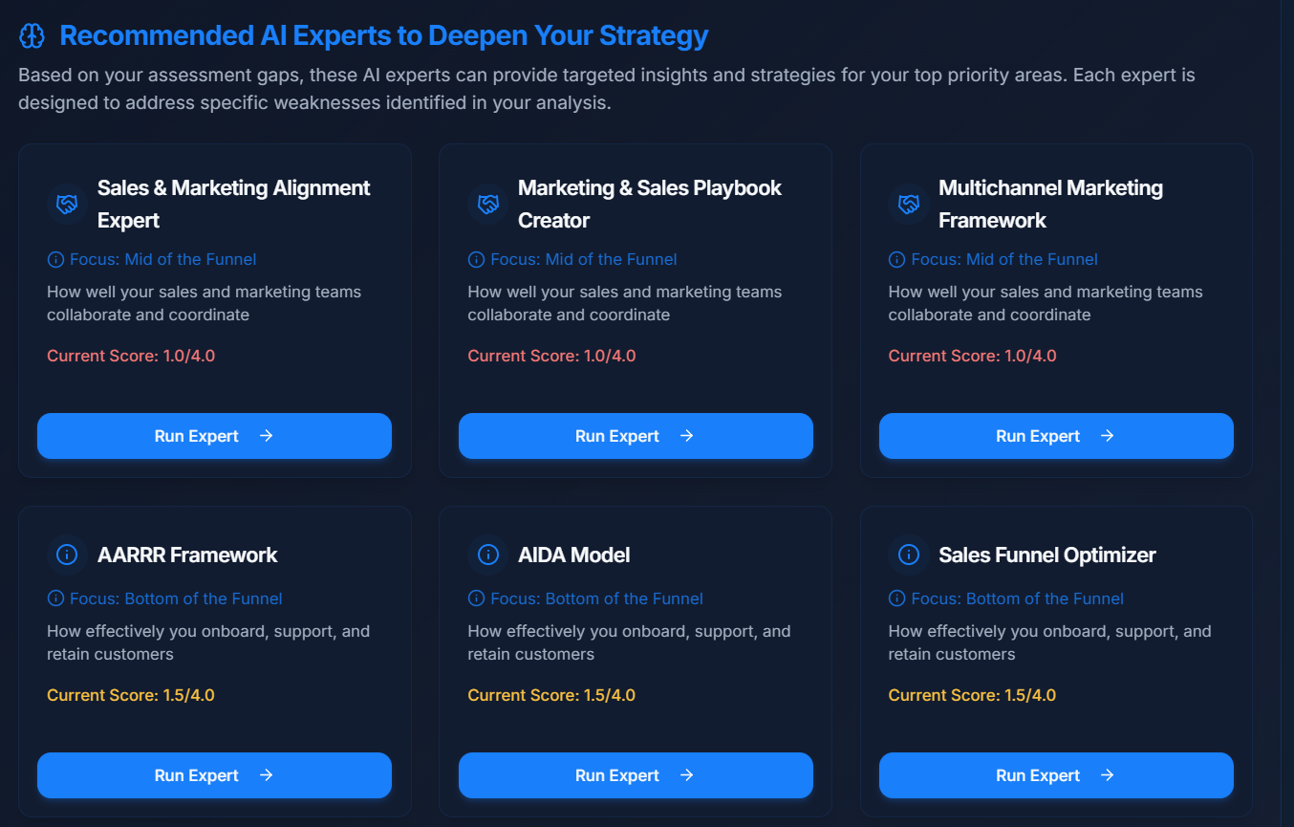
Based on your assessment, you have recommendations
Next

Slide 11

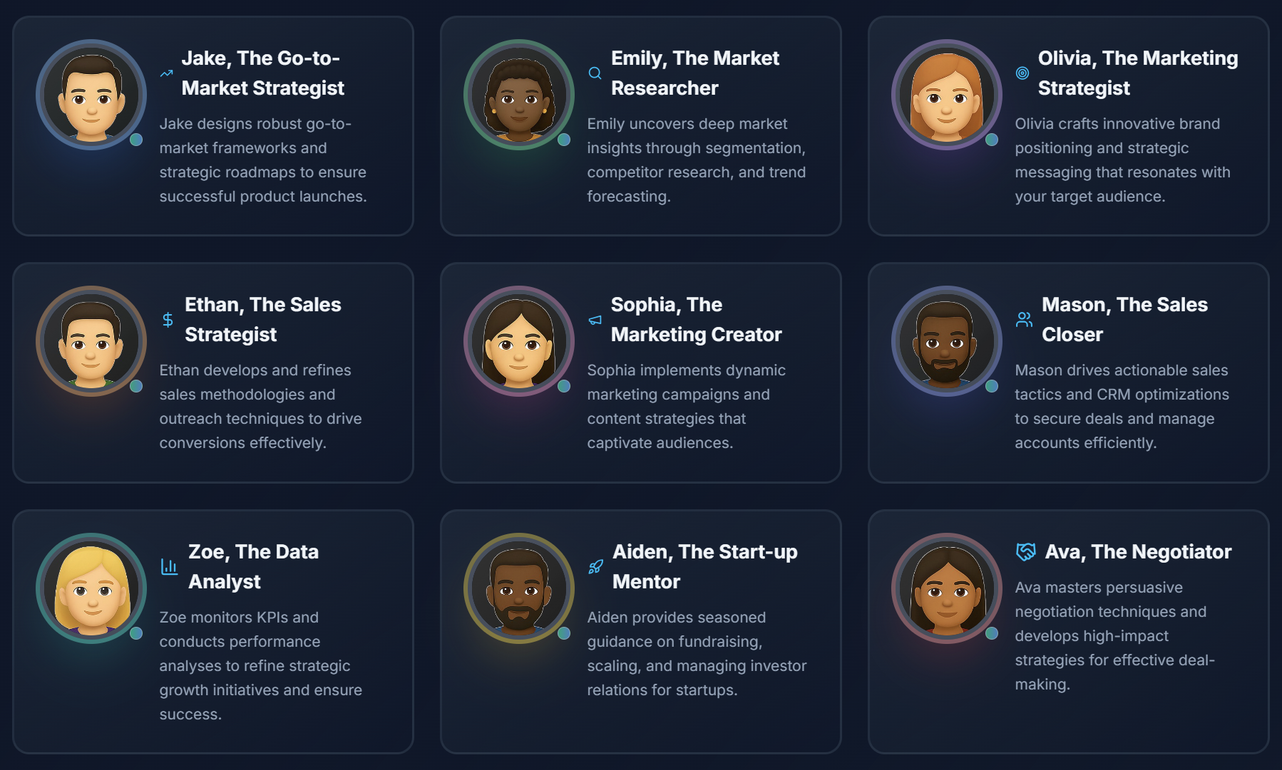
Predictive Sales Forecasting
#3
Choose your Assistants
Next
                David Merzel
                www.davidmerzel.com

Slide 12

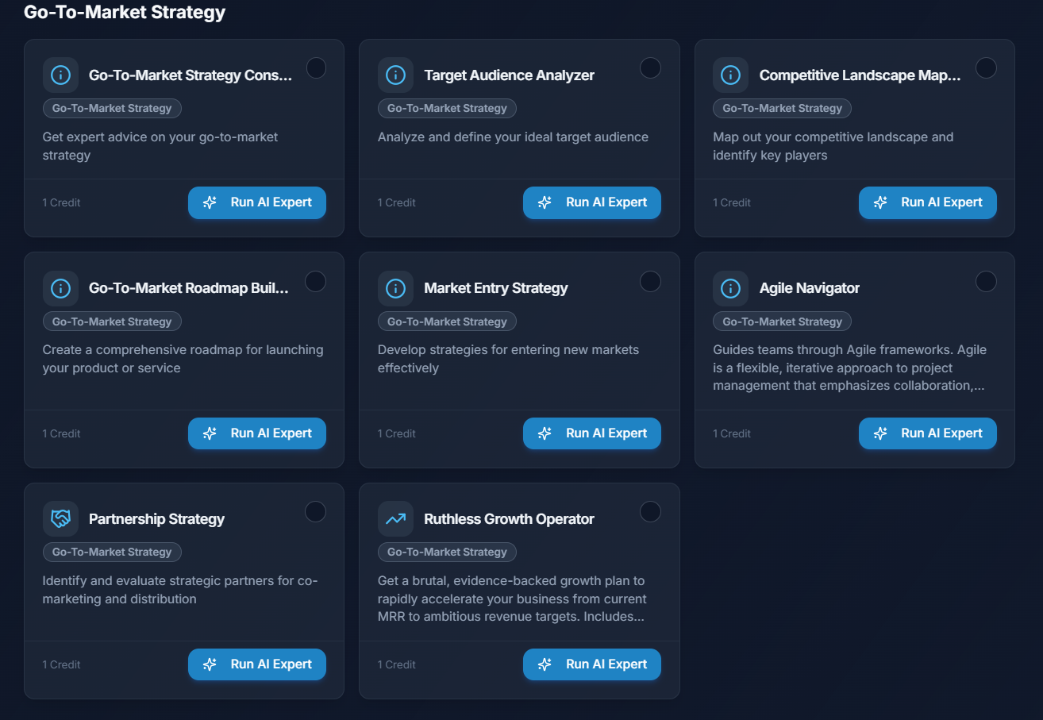
Personalized Customer Journeys
#2
Run your AI Experts
Next
                David Merzel
                www.davidmerzel.com

Slide 13

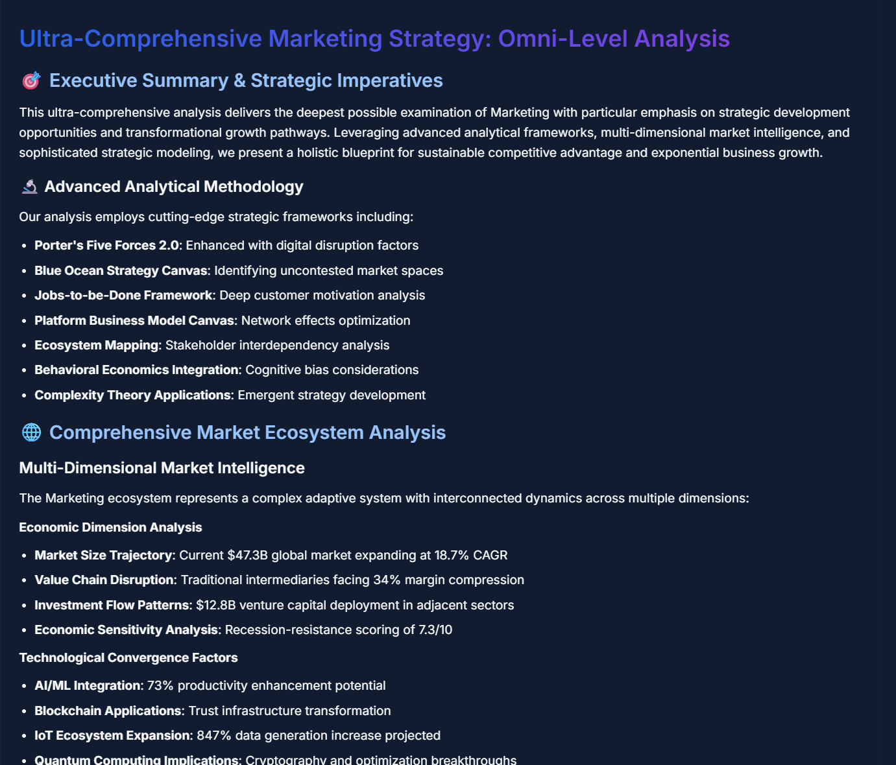
Predictive Sales Forecasting
#3
Review & Download Results
Next
                David Merzel
                www.davidmerzel.com

Slide 14
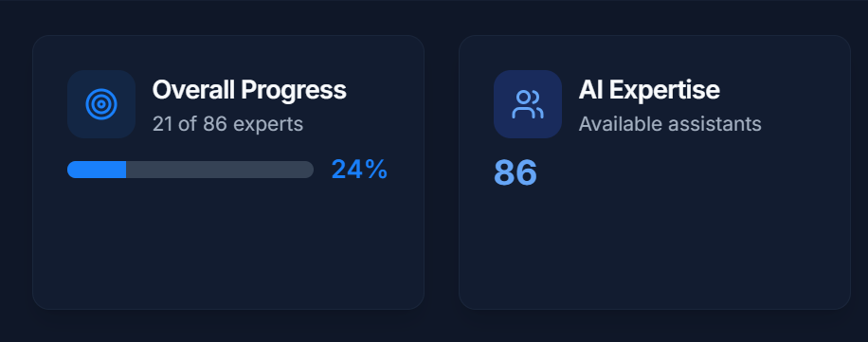
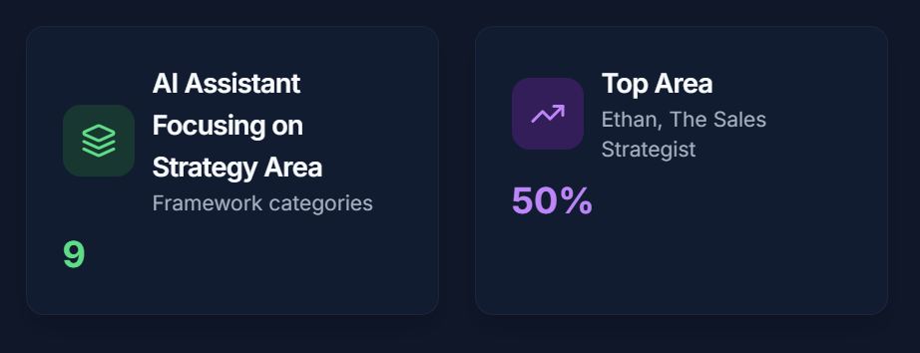
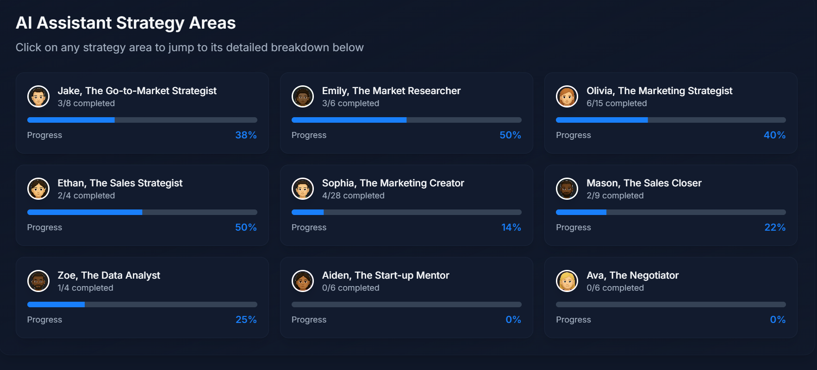
Real Results, Real Impact
Startups using Go-to-Market AI launch faster and grow smarter.
Next

Slide 15

#4
Ready to Build Your Winning Go-to-Market Strategy?
Try Go-to-Market AI for Free—DM me “Free Trial” or visit the link below
https://gtm.davidmerzel.com/

